Slide 1
CST 2355 – Database Systems
Week 6

Slide 2
Topics Covered:
Microsoft SQL Server
Architecture
Connectivity
Data Warehousing tools

Slide 3
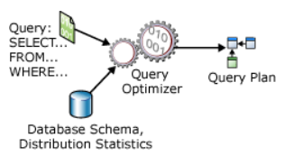
Microsoft SQL Server - Architecture
SQL Server processes queries and optimizes query reuse through execution plan caching NOT data caching
2 modes
Row mode (reads each row entirely for each source table and evaluates rest of query)
Very efficient for OLTP applications (individual lookups and updates).
Batch mode (reads only columns involved in the query; stores columns separately in memory
Very efficient for Data Warehousing – where large amounts of data are read and aggregated
Uses Columnstore indexes

Slide 4
Microsoft SQL Server - Architecture
Query Processing Architecture Guide
https://docs.microsoft.com/en-us/sql/relational-databases/query-processing-architecture-guide?view=sql-server-2017
SQL Server Management Studio has three options to display execution plans:
The Estimated Execution Plan, which is the compiled plan, as produced by the Query Optimizer.
The Actual Execution Plan, which is the same as the compiled plan plus its execution context. This includes runtime information available after the execution completes, such as execution warnings, or in newer versions of the Database Engine, the elapsed and CPU time used during execution.
The Live Query Statistics, which is the same as the compiled plan plus its execution context. This includes runtime information during execution progress, and is updated every second. Runtime information includes for example the actual number of rows flowing through the operators.

Slide 5
Microsoft SQL Server - Modelling
Processing Statements
All statements are similar to SELECT statements; even most DDL is converted into updates into the system catalog tables
May need to create one or more temporary “Worktable” tables in memory for parts of a query plan
Esp. for GROUP BY, ORDER BY, …
SQL Server stores only the source for Triggers and Stored Procedures
Gets re-parsed & re-executed but since identical code each time, it matches the cached queries.

Slide 6
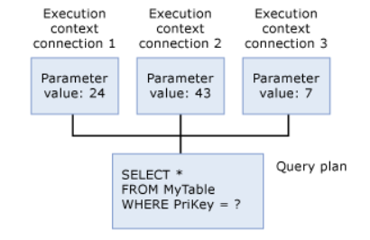
SQL Server – Connection Contexts
Each connection has its own context – own parameters
Share the query plans

Slide 7
SQL Server – Transact-SQL
Transact-SQL was developed by Sybase for their database server, which Microsoft then licensed.
https://en.wikipedia.org/wiki/Transact-SQL
“T-SQL expands on the SQL standard to include procedural programming, local variables, various support functions for string processing, date processing, mathematics, etc. and changes to the DELETE and UPDATE statements.
Transact-SQL is central to using Microsoft SQL Server. All applications that communicate with an instance of SQL Server do so by sending Transact-SQL statements to the server, regardless of the user interface of the application.
Stored procedures in SQL Server are executable server-side routines. The advantage of stored procedures is the ability to pass parameters.”
Has contexts separated by “GO” statements.
Variables can be redefined in separate GO sections.

Slide 8
SQL Server – Transact-SQL GO sections
SQL Server applications can send multiple Transact-SQL statements to an instance of SQL Server for execution as a batch. The statements in the batch are then compiled into a single execution plan.
See discussion at: https://docs.microsoft.com/en-us/sql/t-sql/language-elements/sql-server-utilities-statements-go?view=sql-server-ver15
USE AdventureWorks2012;
GO
DECLARE @MyMsg VARCHAR(50)
SELECT @MyMsg = 'Hello, World.'
GO -- @MyMsg is not valid after this GO ends the batch.
-- Yields an error because @MyMsg not declared in this batch.
PRINT @MyMsg
GO
SELECT @@VERSION;
-- Yields an error: Must be EXEC sp_who if not first statement in
-- batch.
sp_who
GO

Slide 9
SQL Server - Connectivity
To allow remote connections:
Configure Server security parameter(s) (as in lab 4)
Allow remote connections
Configure the Windows Firewall to Allow SQL Server Access
https://docs.microsoft.com/en-us/sql/sql-server/install/configure-the-windows-firewall-to-allow-sql-server-access?view=sql-server-ver15
Ports: TCP 1433, 4022, 135, 1434, UDP 1434. (1433 is main).
.Net applications use “connection strings”
https://docs.microsoft.com/en-us/dotnet/api/system.data.sqlclient.sqlconnection.connectionstring?view=dotnet-plat-ext-5.0
Typical connection string example to connect to “Northwind” database:
"Persist Security Info=False;Integrated Security=true;Initial Catalog=Northwind;server=(local)“
If remote, server changes to:
server=tcp:servername, portnumber

Slide 10
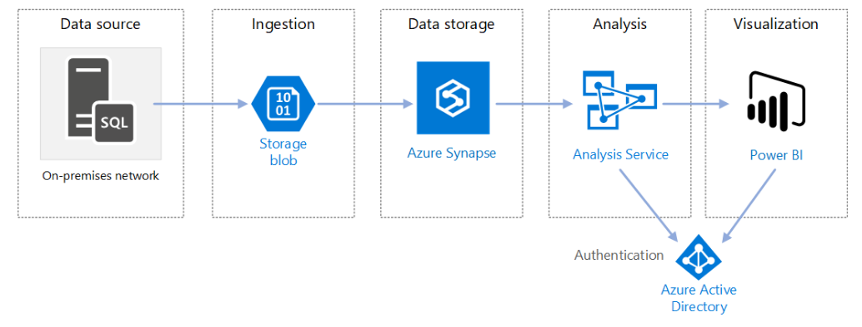
SQL Server - Data Warehousing Tools
Data warehouses store current and historical data and are used for reporting and analysis of the data.
LOTS of recent development by Microsoft in this area:

Slide 11
SQL Server - Data Warehousing Tools
See Azure discussion at: https://docs.microsoft.com/en-us/azure/architecture/data-guide/relational-data/data-warehousing
Current focus is on integration with input/output technologies and focus on “Live” data connections rather than Extract-Transform-Load workflows
MANY add-on products available for SQL Server to do analytics and reporting
E.g., Tableau

